Slide 1

ATHENA LEARNING HUB
The Vanishing
Lighthouse
KS1–KS2 English
Read clues • solve the mystery • describe the scene
90-MINUTE SAMPLE SESSION
Notes:
[Sources]
Original KS1–KS2 sample English session developed for Athena Learning Hub.
Original illustration generated by Athena Learning Hub.

Slide 2
90-MINUTE SAMPLE SESSION • KS1–KS2
What we will learn today
Find answers in the story
Use clues to make a sensible guess
Choose strong describing and action words
Write a clear mystery description
10 min • visual hook
20 min • shared reading
15 min • comprehension
15 min • language lab
20 min • independent writing
10 min • review and exit
Accessible throughout: speak • point • draw • type • write
ATHENA LEARNING HUB • Learn. Grow. Lead.
2
Notes:
[Sources]
Original KS1–KS2 sample English session developed for Athena Learning Hub.

Slide 3
90-MINUTE SAMPLE SESSION • KS1–KS2
Look closely: what do you think happened?
Look at the picture. Use what you can see to share an idea.
SPOT
THINK
ASK
GUESS
Name three things you can see.
What might have happened?
What would you like to know?
What might happen next?
Say: I can see… I think… Maybe…
ATHENA LEARNING HUB • Learn. Grow. Lead.
3
Notes:
[Sources]
Original KS1–KS2 sample English session developed for Athena Learning Hub.

Slide 4
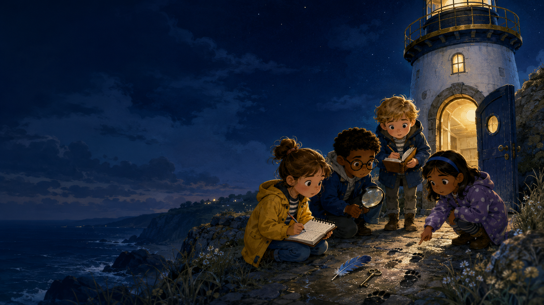
SHARED READING
The Vanishing Lighthouse
At sunset, the lighthouse beam vanished. Maya, Leo, Grace and Sam rowed towards the rocky island. Near the blue door, they found a silver key, a damp feather and a trail of tiny footprints. The tower was silent, but a warm light flickered behind the highest window. “Someone is inside,” whispered Grace.
Tutor reads • echo read • team read
Notes:
[Sources]
Original KS1–KS2 sample English session developed for Athena Learning Hub.
Original illustration generated by Athena Learning Hub.

Slide 5
90-MINUTE SAMPLE SESSION • KS1–KS2
Find the answers and use the clues
1
When did the beam vanish?
2
Name two clues beside the door.
3
Why does Grace whisper? Use one clue.
4
What might the warm light suggest?
Find and point to the helpful words before you answer.
ATHENA LEARNING HUB • Learn. Grow. Lead.
5
Notes:
[Sources]
Original KS1–KS2 sample English session developed for Athena Learning Hub.

Slide 6
90-MINUTE SAMPLE SESSION • KS1–KS2
Word Explorer
vanished
damp
disappeared suddenly
slightly wet
flickered
silent
shone unsteadily
without sound
Choose one word and use it in your own lighthouse sentence.
ATHENA LEARNING HUB • Learn. Grow. Lead.
6
Notes:
[Sources]
Original KS1–KS2 sample English session developed for Athena Learning Hub.

Slide 7
90-MINUTE SAMPLE SESSION • KS1–KS2
Make the lighthouse feel mysterious
SIGHT
SOUND
MOVEMENT
FEELING
a pale moon above the tower
waves slapped the rocks
the weak light trembled
unease tightened in Maya’s chest
Which idea makes the scene feel most mysterious? Tell us why.
ATHENA LEARNING HUB • Learn. Grow. Lead.
7
Notes:
[Sources]
Original KS1–KS2 sample English session developed for Athena Learning Hub.

Slide 8
LET’S LOOK AT A MODEL
See how strong details make the scene clear
The lonely lighthouse leaned above the restless sea. Waves slapped the black rocks while its weak golden light trembled behind the glass. Maya gripped the cold key and stepped towards the silent blue door.
Underline a describing phrase • circle a strong action word
ATHENA LEARNING HUB • Learn. Grow. Lead.
8
Notes:
[Sources]
Original KS1–KS2 sample English session developed for Athena Learning Hub.

Slide 9
90-MINUTE SAMPLE SESSION • KS1–KS2
Plan the mystery
1
Where is the character?
2
What can be seen and heard?
3
Which clue is discovered?
4
How does the character feel?
5
What happens next?
A focused plan gives the writing direction.
ATHENA LEARNING HUB • Learn. Grow. Lead.
9
Notes:
[Sources]
Original KS1–KS2 sample English session developed for Athena Learning Hub.

Slide 10
90-MINUTE SAMPLE SESSION • KS1–KS2
Now write your own mystery description
Describe the moment the children approach the lighthouse door. Write 3–5 sentences for KS1 or one developed paragraph for KS2.
START
WRITE
READ
IMPROVE
Use your plan.
Write one sentence at a time.
Read it back.
Change one weak word.
One instruction at a time. Use a keyboard or scribe if required.
ATHENA LEARNING HUB • Learn. Grow. Lead.
10
Notes:
[Sources]
Original KS1–KS2 sample English session developed for Athena Learning Hub.

Slide 11
90-MINUTE SAMPLE SESSION • KS1–KS2
Check your writing
✓
Capital letter and end mark
✓
One precise adjective
✓
One strong verb
✓
One sensory detail
Underline your best words. Change one part to make it clearer.
ATHENA LEARNING HUB • Learn. Grow. Lead.
11
Notes:
[Sources]
Original KS1–KS2 sample English session developed for Athena Learning Hub.

Slide 12
90-MINUTE SAMPLE SESSION • KS1–KS2
Show what you know
A
B
Retrieve: Where was the warm light?
Infer: Why might the children feel nervous?
C
D
Improve: The sea was bad.
Write one sentence using flickered.
Try each question by yourself first. Then talk about your answers.
ATHENA LEARNING HUB • Learn. Grow. Lead.
12
Notes:
[Sources]
Original KS1–KS2 sample English session developed for Athena Learning Hub.

Slide 13
90-MINUTE SAMPLE SESSION • KS1–KS2
Check your answers
Answers
• at sunset
• silver key, damp feather, tiny footprints
• Grace may be cautious or nervous; the tower is silent and someone may be inside
• the warm light suggests a person or activity in the tower
• warm light: behind the highest window
Accept sensible predictions supported by a clue.
Other answers can be correct when a clue supports the idea.
ATHENA LEARNING HUB • Learn. Grow. Lead.
13
Notes:
[Sources]
Original KS1–KS2 sample English session developed for Athena Learning Hub.

Slide 14
EXIT TICKET
What did you learn in the lighthouse mystery?
1
One clue I used
2
One writing idea I tried
3
My next goal
Read carefully • share your ideas • choose strong words
ATHENA LEARNING HUB • Learn. Grow. Lead.
Notes:
[Sources]
Original KS1–KS2 sample English session developed for Athena Learning Hub.

