Slide 1

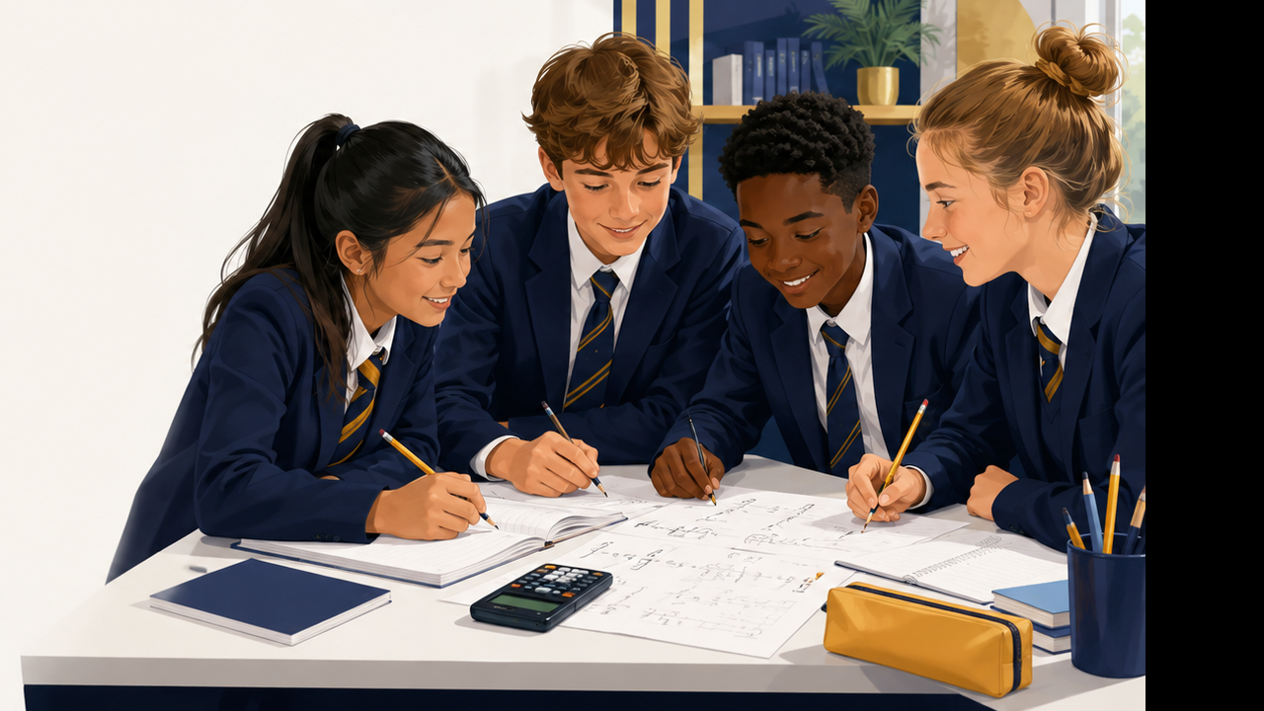
SAMPLE SESSION
KS3 & KS4
MATHEMATICS
Confidence-building teaching, guided practice and exam-style problem solving.
Athena Learning Hub Ltd
07784 165561
athenalearninghub@outlook.com
www.athenalearninghub.co.uk

Slide 2
Session Flow
A clear learning journey for pupils, parents and tutors
1
Retrieval
2
Teach
3
Practise
4
Review
Quick confidence check to warm up key knowledge.
Short, clear explanations with visual modelling.
Guided questions followed by independent attempts.
Answers, feedback and next-step targets.
?
Both sample sessions are designed to build confidence, accuracy and mathematical vocabulary.
07784 165561
athenalearninghub@outlook.com
www.athenalearninghub.co.uk

Slide 3

KS3 SESSION
Algebra Foundations
Learning aim: simplify expressions and solve equations using clear steps.
• Understand terms, variables and coefficients
• Collect like terms accurately
• Use inverse operations to solve equations
• Explain each step using mathematical vocabulary
Success criteria
I can show working, check answers, and correct mistakes.
07784 165561
athenalearninghub@outlook.com
www.athenalearninghub.co.uk

Slide 4
KS3: Mathematical Language
What is an expression?
?
Top tip: key words such as more than, less than, twice, sum and difference help you choose the correct operation.
An expression is a number, a letter, or a combination of numbers and letters with operations, but no equals sign.
Examples
2x + 5 4y a − 3 3b + 2c − 7
TRY IT
Write an expression for each situation:
1
A number x increased by 6
3
Seven less than a number n
2
Twice a number y
4
The sum of 3a and 8
07784 165561
athenalearninghub@outlook.com
www.athenalearninghub.co.uk

Slide 5
KS3: Collecting Like Terms
Simplify by grouping matching variables
?
Check: Are the variable letters the same?
Worked example
Why it works
Simplify: 3x + 5 + 2x − 4
Only like terms can be combined.
Terms with x combine with x. Numbers combine with numbers.
Step 1 Group like terms: (3x + 2x) + (5 − 4)
Step 2 Add or subtract: 5x + 1
Your turn
a) 4x + 3 + 2x − 5 b) 7b − 2 + 3b + 6 c) 5x + 4y + 2x − y
07784 165561
athenalearninghub@outlook.com
www.athenalearninghub.co.uk

Slide 6
KS3: Solving Equations
Keep the equation balanced
Worked example
Now you try
2x + 5 = 15
1
x + 7 = 15
3x − 4 = 14
Remember
Subtract 5 from both sides
2x = 10
Divide both sides by 2
x = 5
2
Do the same operation to both sides.
3
2(x + 3) = 16
4
5x + 2 = 27
?
Mini check: What is the inverse of adding 7?
07784 165561
athenalearninghub@outlook.com
www.athenalearninghub.co.uk

Slide 7
KS3 Practice Activity
Work independently, then compare strategies
A. Simplify
B. Solve
C. Explain
1) 4x + 3 + 2x − 5
2) 7b − 2 + 3b + 6
3) 5x + 4y + 2x − y
1) x + 7 = 15
2) 3x − 4 = 14
3) 2(x + 3) = 16
4) 5x + 2 = 27
Explain why we do the same operation to both sides of an equation.
Sentence starter:
“We must keep the equation balanced because…”
?
Target: show every step clearly, even when the answer feels obvious.
07784 165561
athenalearninghub@outlook.com
www.athenalearninghub.co.uk

Slide 8
KS3 Feedback & Answers
Use the answer key to spot next steps
A. Simplify
B. Solve
1) 4x + 3 + 2x − 5
1) x + 7 = 15
6x − 2
x = 8
2) 3x − 4 = 14
2) 7b − 2 + 3b + 6
x = 6
10b + 4
3) 2(x + 3) = 16
3) 5x + 4y + 2x − y
x = 5
7x + 3y
4) 5x + 2 = 27
x = 5
Next-step targets: organise working in columns • check by substituting the answer • explain the inverse operation used.
07784 165561
athenalearninghub@outlook.com
www.athenalearninghub.co.uk

Slide 9

KS4 SESSION
GCSE Problem Solving
Focus: quadratic equations, graphs and applied reasoning.
• Factorise a quadratic expression
• Solve by setting each bracket to zero
• Connect algebra to graph roots
• Apply Pythagoras and trigonometry in exam-style questions
?
Exam habit: write the method as well as the answer.
07784 165561
athenalearninghub@outlook.com
www.athenalearninghub.co.uk

Slide 10
KS4: Factorising Quadratics
Find two numbers with a product and a sum
A quadratic often has the form:
Example
ax² + bx + c = 0
x² + 5x + 6
Multiply to 6: 2 and 3
Add to 5: 2 + 3 = 5
Factorised form: (x + 2)(x + 3)
When a = 1, look for two numbers that multiply to c and add to b.
?
Your turn: factorise x² + 7x + 10
?
Challenge: factorise x² − 4x − 12
07784 165561
athenalearninghub@outlook.com
www.athenalearninghub.co.uk

Slide 11
KS4: Solving by Factorising
Use the zero-product rule
Worked example
Now you try
Solve: x² + 5x + 6 = 0
a) x² + 7x + 10 = 0
b) x² − 4x − 12 = 0
c) 2x² + 3x − 2 = 0
Step 1 Factorise: (x + 2)(x + 3) = 0
Step 2 Set each bracket to zero:
x + 2 = 0 or x + 3 = 0
Step 3 Solve:
x = −2 or x = −3
?
Top tip: substitute solutions back into the original equation to check they work.
07784 165561
athenalearninghub@outlook.com
www.athenalearninghub.co.uk

Slide 12
KS4: Graph Connection
Solutions are where the graph crosses the x-axis
Example
y
y = x² − 4x + 3
Factorise: y = (x − 1)(x − 3)
The roots are x = 1 and x = 3.
This means the graph crosses the x-axis at 1 and 3.
x
Roots
?
Question: what are the roots of y = x² − 9?
07784 165561
athenalearninghub@outlook.com
www.athenalearninghub.co.uk

Slide 13
KS4: Applied Geometry
Pythagoras and trigonometry in context
Pythagoras
Trigonometry
sin θ = opposite / hypotenuse
a² + b² = c²
cos θ = adjacent / hypotenuse
tan θ = opposite / adjacent
Example: sides 5 cm and 12 cm
5² + 12² = 169, so c = 13 cm
?
Practice: find the hypotenuse when the shorter sides are 8 cm and 15 cm.
?
Practice: sin θ = 7/10. Estimate θ to 1 decimal place.
07784 165561
athenalearninghub@outlook.com
www.athenalearninghub.co.uk

Slide 14
KS4 Exam-Style Practice
Plan, solve, check
Question 1
Question 2
The area of a rectangle is x² + 7x + 10.
a) Factorise the expression.
b) Use your answer to suggest two possible side lengths.
A ladder is 10 m long and reaches 8 m up a wall.
How far is the base of the ladder from the wall?
8 m
10 m
?
Show your working. Award yourself one mark for method and one for accuracy.
07784 165561
athenalearninghub@outlook.com
www.athenalearninghub.co.uk

Slide 15
KS4 Feedback & Answers
Mark, correct and set a target
Quadratics
Applied geometry
a) x² + 7x + 10 = 0
(x + 5)(x + 2) = 0
x = −5 or x = −2
b) x² − 4x − 12 = 0
(x − 6)(x + 2) = 0
x = 6 or x = −2
Hypotenuse with sides 8 and 15:
8² + 15² = 289, so c = 17 cm
Ladder question:
10² − 8² = 36, so distance = 6 m
sin θ = 7/10 gives θ ≈ 44.4°
Self-check: Did I use the correct method? Did I write each step? Did I check the answer makes sense?
07784 165561
athenalearninghub@outlook.com
www.athenalearninghub.co.uk

Slide 16
Next Steps
Book a diagnostic conversation and receive a personalised learning plan for KS3 or KS4 mathematics.
• One-to-one or small group tuition
• Confidence, homework and exam preparation
• Clear feedback after each session
INSPIRE | EMPOWER | ACHIEVE
07784 165561
athenalearninghub@outlook.com
www.athenalearninghub.co.uk

